Slide 1

Short Introduction to Neural Networks
EE4685
Machine Learning:
a Bayesian Perspective
2023/2024
Q3
dr. ir. Justin Dauwels

Slide 2
Learning objectives
After this lecture, you should be able to answer the following questions:
What can neural networks (NNs) be used for?
What are NNs?
What are the key steps in designing NNs?

Slide 3
Neural Networks (NNs)
What can NNs be used for?
What are NNs?
What are the key steps in designing NNs?

Slide 4
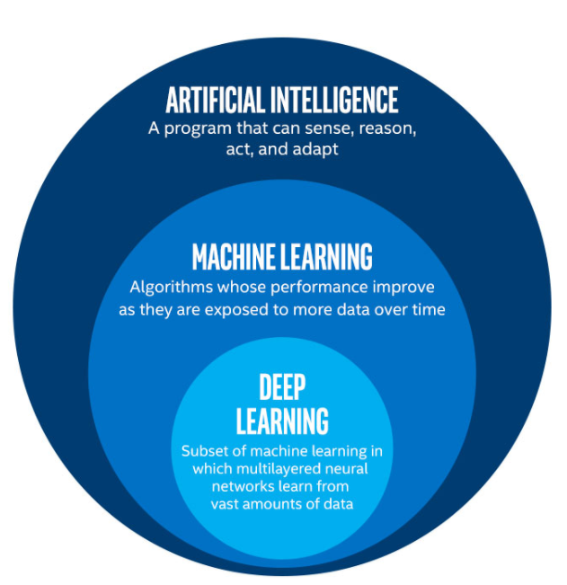
Neural networks are specific type of Artificial Intelligence (AI)

Slide 5
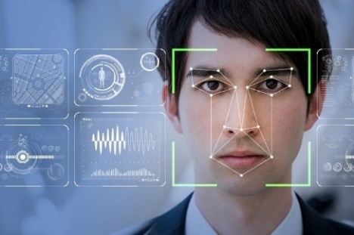

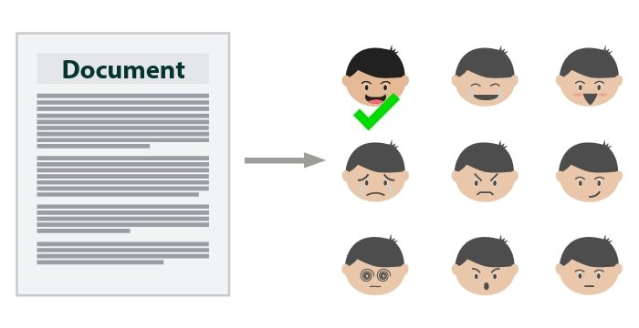




Applications of Artificial Intelligence (and NNs in particular)
Image Recognition
Sentiment analysis
Speech Recognition
Email/Spam Filtering
Medical Diagnostics and Services
Recommendation systems
Autonomous cars
Online Fraud Detection
https://www.ubuntupit.com/

Slide 6
Neural Networks (NNs)
What can NNs be used for?
What are NNs?
What are the key steps in designing NNs?

Slide 7
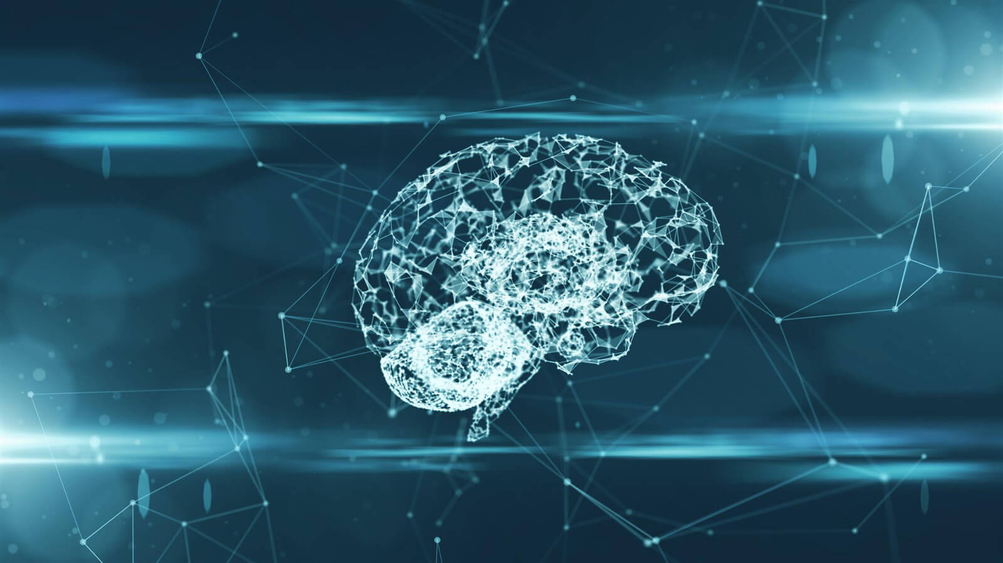
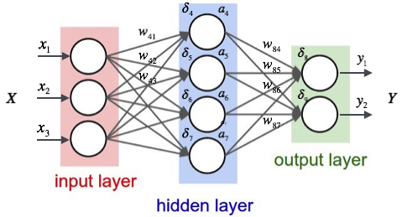
Inspiration of Neural Networks
Neuron networks are inspired by human brain.
Left: https://community.arm.com/developer/ip-products/processors/b/processors-ip-blog/posts/new-neural-network-kernels-boost-efficiency-in-microcontrollers-by-5x
Right: https://medium.com/datadriveninvestor/letting-neural-networks-be-weird-6792ea587d67

Slide 8

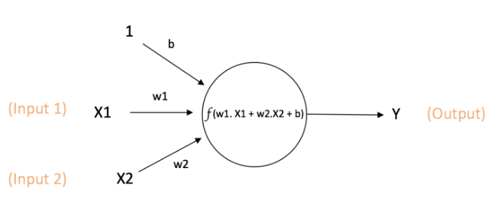
A Single Neuron
A neuron takes inputs, performs computation, and produces an output.
Reference: https://towardsdatascience.com/machine-learning-for-beginners-an-introduction-to-neural-networks-d49f22d238f9

Slide 9
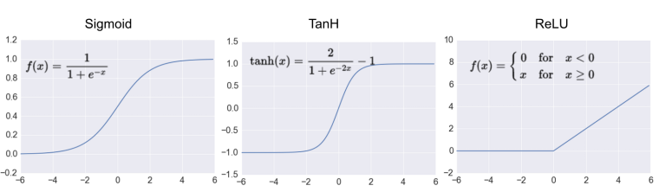
Activation Functions
Reference: https://www.kdnuggets.com/2017/09/neural-network-foundations-explained-activation-function.html

Slide 10
A Single Neuron: Geometric interpretation
Reference: https://towardsdatascience.com/machine-learning-for-beginners-an-introduction-to-neural-networks-d49f22d238f9

Slide 11
A Single Neuron: Geometric interpretation
X₂
X₁
Reference: https://towardsdatascience.com/machine-learning-for-beginners-an-introduction-to-neural-networks-d49f22d238f9

Slide 12

Can a single line separate red from blue dots?
Yes
No
X₂
“0”
“1”
1
0
1
X₁

Slide 13
Can a single line separate red from blue dots?
Yes
No
X₂
XOR problem
“0”
“1”
1
0
1
X₁

Slide 14
One neuron can’t solve XOR problem
X₂
“0”
“1”
1
0
1
X₁
One line can’t separate red from blue dots

Slide 15

How many lines are needed?
1
2
3
4
X₂
1
0
1
X₁
One line can’t separate red from blue dots

Slide 16
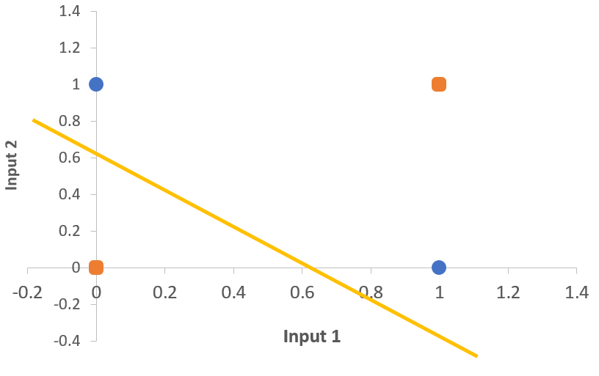
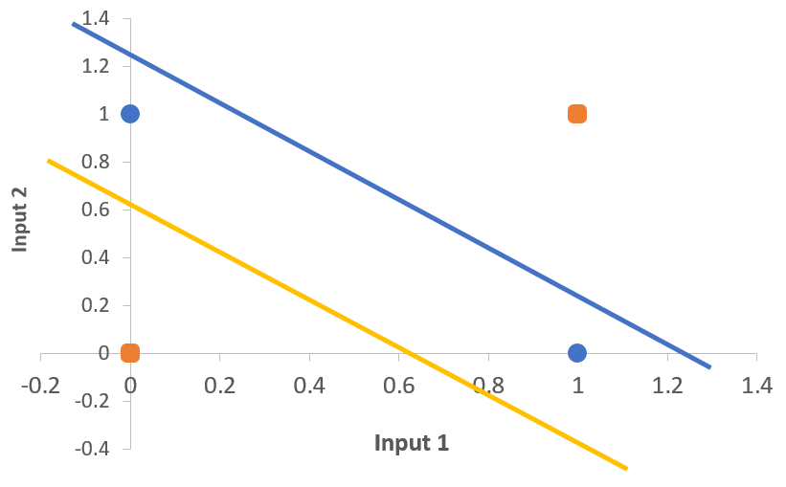
XOR Problem
One line can’t separate XOR region.
One neuron can’t solve XOR problem.
Two lines can separate XOR region.
Two neurons can solve XOR problem.
Reference: http://toritris.weebly.com/perceptron-4-formalising--visualising.html

Slide 17
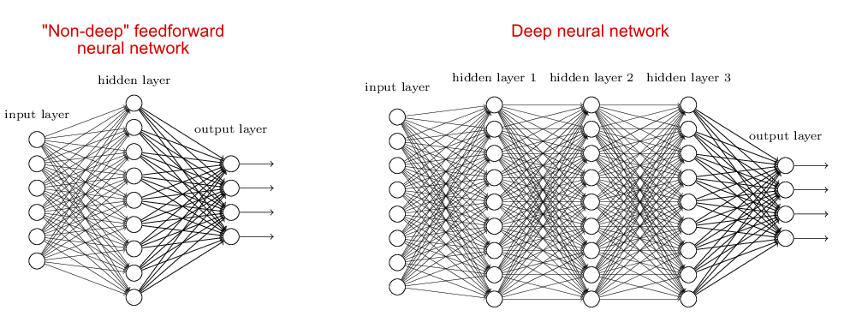
Multi-Layer Perceptron
Reference: https://stats.stackexchange.com/questions/182734/what-is-the-difference-between-a-neural-network-and-a-deep-neural-network-and-w

Slide 18
Neural Networks
What can NNs be used for?
What are NNs?
What are the key steps in designing NNs?

Slide 19
Design of Neural Networks
Choose a network architecture
Choose an objective function
Apply stochastic gradient descent (Backpropagation)

Slide 20
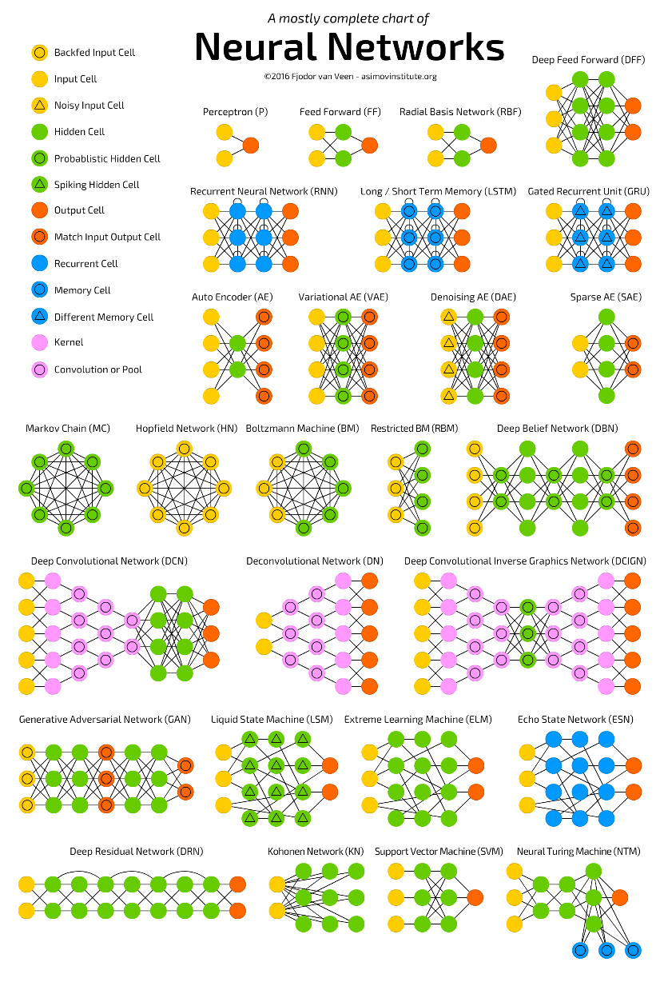
Choose a network architecture
Many options!
Feedforward, recurrent, etc.
Types of activation functions
Number of layers and neurons
Still a open problem to find the “best” architecture for a given problem…

Slide 21
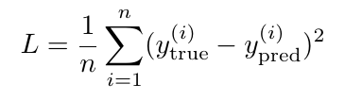
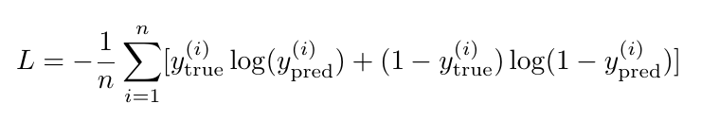
2. Choose an objective function
Two popular objective functions:
Mean Squared Error:
Cross Entropy (binary classification):

Slide 22
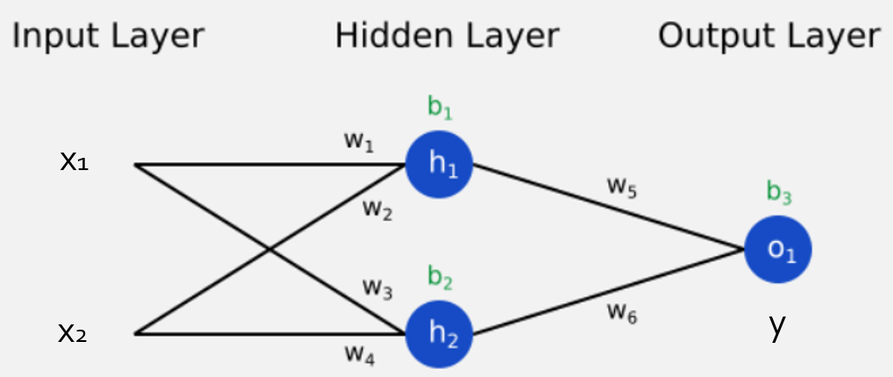
3. Apply stochastic gradient descent (Backpropagation)
Assume MSE as loss function
Update by gradient descent
Reference: https://towardsdatascience.com/machine-learning-for-beginners-an-introduction-to-neural-networks-d49f22d238f9

Slide 23
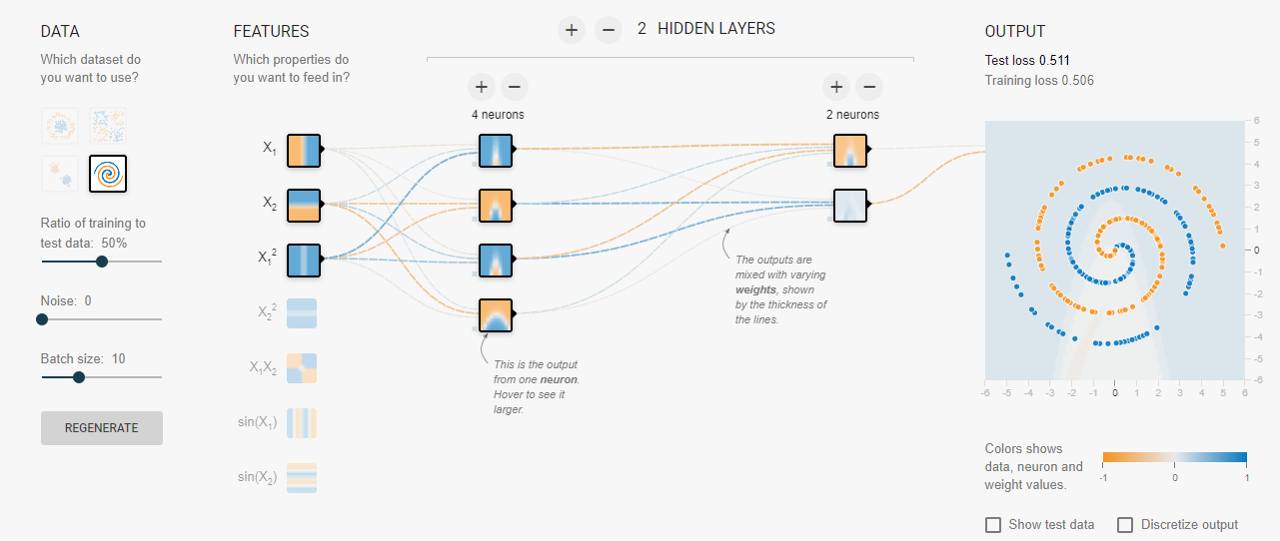
Let’s design our own neural network ☺
By Daniel Smilkov and Shan Carter
Go to https://playground.tensorflow.org/
Notes:
Shallow layers: simple features (e.g. edges)
Deep layers: more complicated features (e.g. shape)

Slide 24
Conclusion: Neural networks
What can NNs be used for?
What are NNs?
What are the key steps in designing NNs?
Choose a network architecture
Choose an objective function
Apply stochastic gradient descent (Backpropagation)

Slide 25
Short Introduction to Neural Networks
EE4685
Machine Learning:
a Bayesian Perspective
2023/2024
Q3
dr. ir. Justin Dauwels

